Slide 1


Trends in US Breweries
A repot prepared for Brewing Bros
by Tajar, Inc.
Data from the American Beer and Wine Association
June 26, 2018

Slide 2
The TAJAR, Inc Team:
Rajat Chandna
Andy Ho
An Nguyen
Jodi Pafford
Tori Wheelis

Slide 3
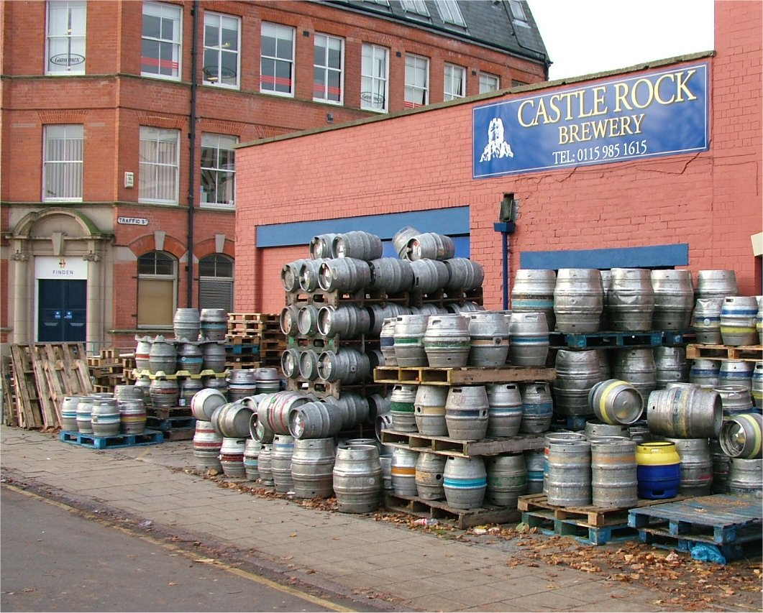
The Brewery File:
Data File with Brewery Information
This Photo by Unknown Author is licensed under CC BY-SA

Slide 4
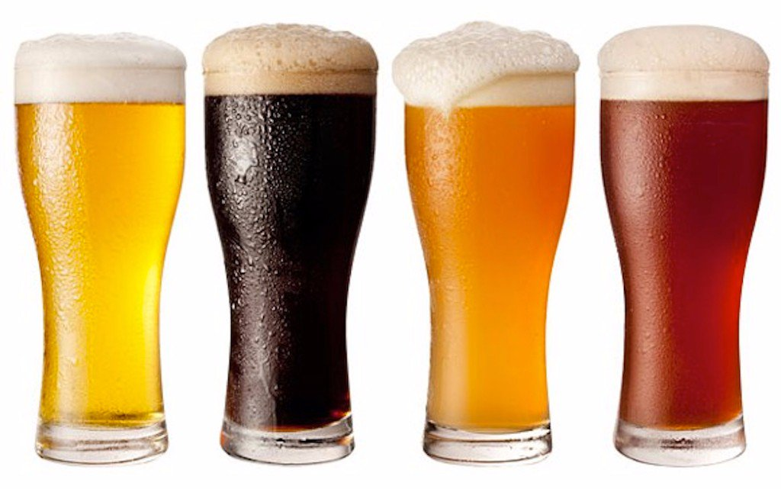
The Beers File:
Original file has 2,410 lines of data
Removal of obvious duplicates
Search beginning and ending strings
Prepare File for Merging
Final File, CleanedBeerData, used to merge, contains 2,366 different types of beer
This Photo by Unknown Author is licensed under CC BY-NC-ND

Slide 5
Example of Data
Insert Data for Question 2 – Print the first 6 observations and the last 6 observations.

Slide 6
Further Discoveries:
Insert data for question 3 – How many N/As are in each column

Slide 7
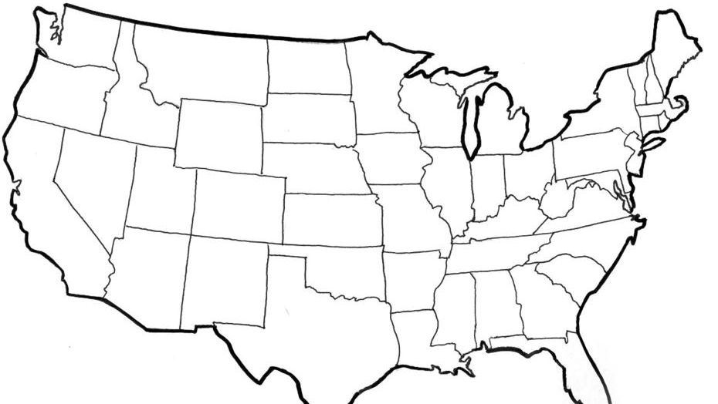
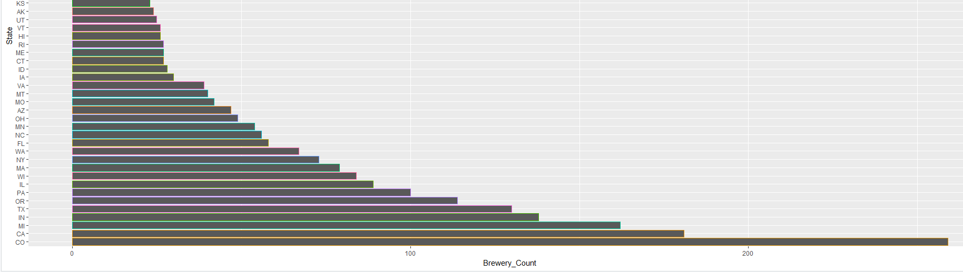
US Brewery Locations
This Photo by Unknown Author is licensed under CC BY-SA

Slide 8
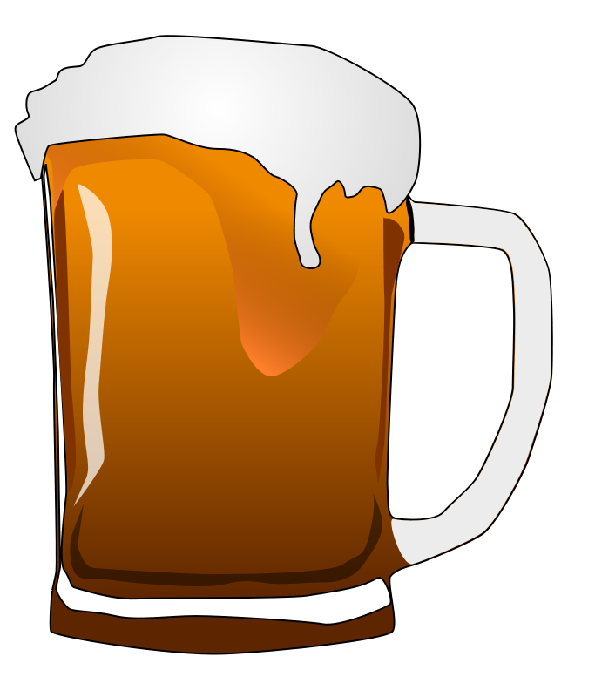
Median Alcohol Content & International Bitterness Units
Highlight a few states from question 4 – Median alcohol content and international bitterness units

Slide 9
Median Alcohol Content & International Bitterness Units
Highlight a few states from question 4 – Median alcohol content and international bitterness units

Slide 10
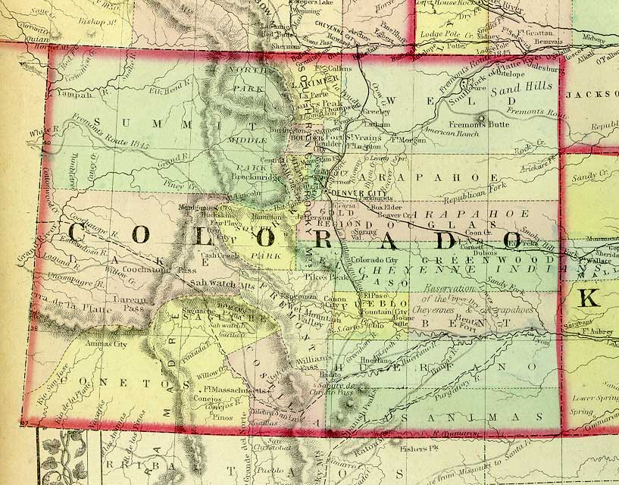

Maximum ABV
1.25%
This Photo by Unknown Author is licensed under CC BY-NC-SA

Slide 11
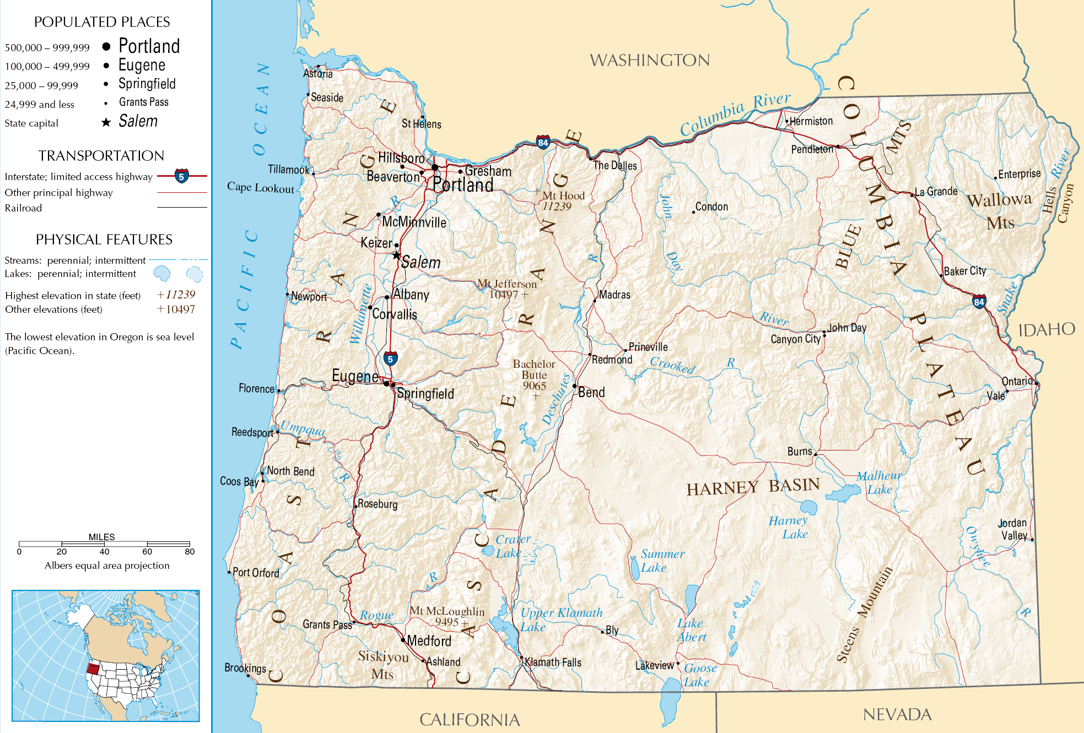

Most Bitter (IBU)
138
This Photo by Unknown Author is licensed under CC BY-SA

Slide 12
Other Notable Information about ABV
Summary Stats about ABV from question 6

Slide 13
IBU vs ABV Relationship?
Insert scatterplot from question 7

Slide 14

Questions?

Slide 15
Thank You for allowing us to partner with you

